Slide 1


2509ICT Software Engineering
Modeling Language Part A -
Behavior Trees
Professor R.G. Dromey
School of Information and Communication Technology
Lecture 3
© R.G.Dromey, Griffith University, 2007

Slide 2
“You can’t do things differently,
Until you see things differently”.
Unknown

Slide 3
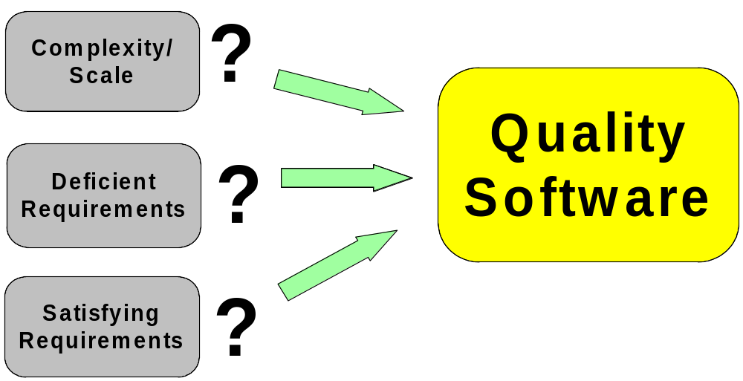
Threats to Project Success
These Problems are all interdependent

Slide 4
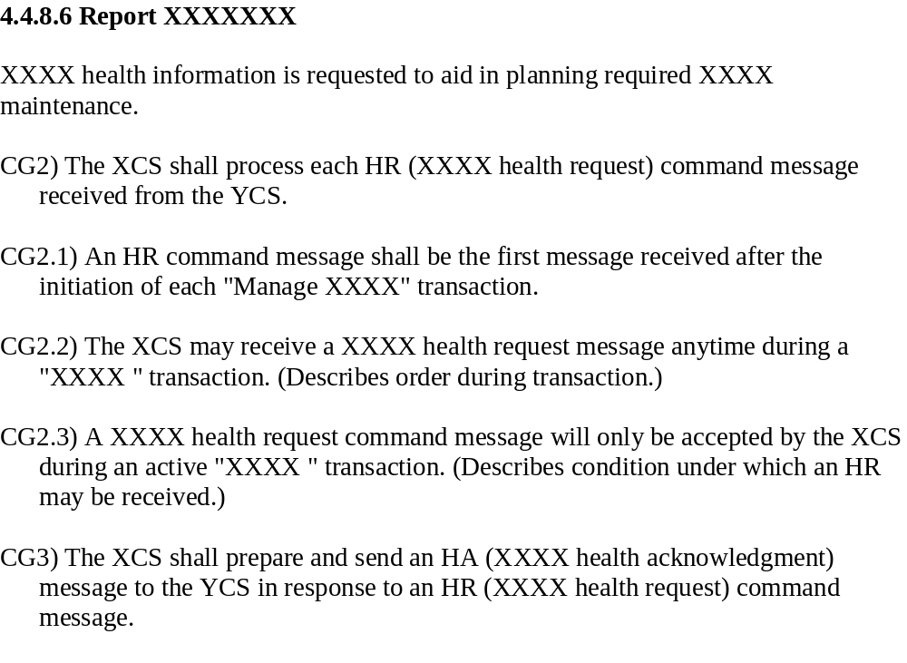
Problem 1 - Complexity
Thousands of requirements like this
Scale + Interaction => Complexity

Slide 5

Problem 2 – Deficient Requirements
“Deficient Requirements are the single
biggest cause of project failure”

Slide 6
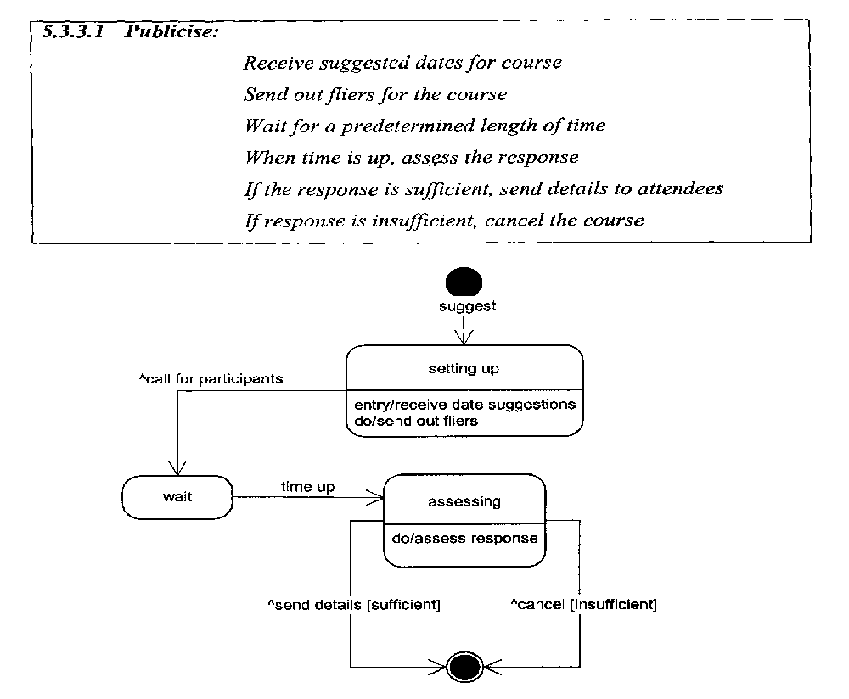
Problem 3 - Satisfying Requirements - Example
USE-CASE
Participants?
Claimed to be
“equivalent” to
text version on
page .226
VOCABULARY CHANGES
State-Chart
Use-case ---
Statechart Representation
1. “Course” omitted
2. “Participants” introduced
3. “Attendees” omitted
4. “Predetermined length of time” omitted
5. “Setting up” introduced
6. “Entry” introduced
7. “Do” introduced
8. “Call for” introduced
Course???
Attendees???
Loss of original intention – major issue

Slide 7
Current Software Engineering - Strategy
Build system to
satisfy
the requirements
This is TOO Hard
Current SE Methods – Fail to consistently deliver

Slide 8
A Lesson From Mathematics
“All mathematics exhibits in its conclusions
only what is already implicit in its premises
-- all mathematical derivation can be viewed
simply as change in representation,
making evident what was previously
true but obscure.”
- Herbert Simon
Treat Requirements like Premises

Slide 9
Alternative Way of Thinking
Build system
OUT OF
its requirements
REPRESENTATION – is the key to doing this

Slide 10
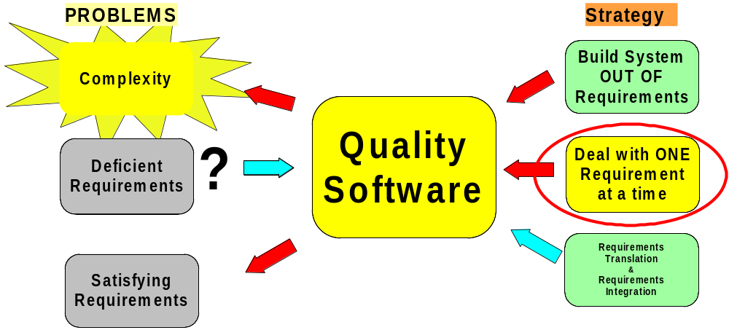
Behavior Engineering
Tackling Complexity Head-on

Slide 11
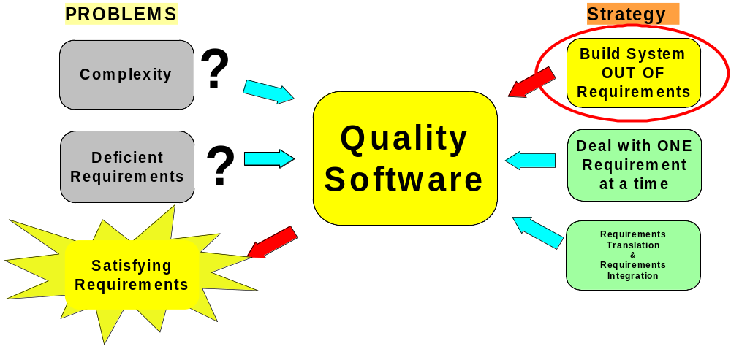
Behavior Engineering
Tackling Verification & Validation Head-on

Slide 12
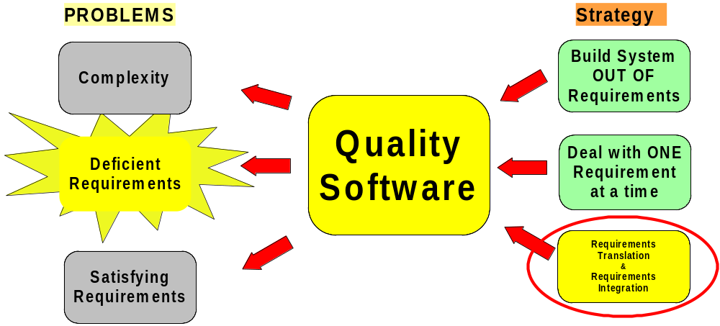
Behavior Engineering
Tackling Deficient Requirements Head-on

Slide 13
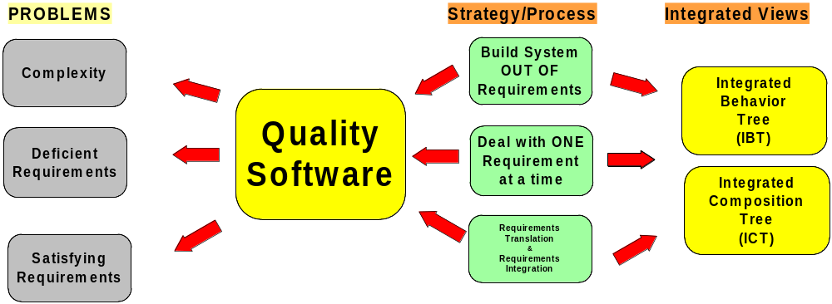
Behavior Engineering
Tackling Software Engineering’s Problems Head-on

Slide 14
Requirements in Natural Language
● Large numbers of requirements overflow our
short-term memory
Ambiguity, and many other types of defects
are not “visible” in sequential text
Can’t grasp what system does as a “whole”
How do we organize teams to work
productively?
Formalization - Modelling our only hope

Slide 15
Formalization - Challenges
• Accuracy – How to preserve original intent?
• Validation – Understandable by stakeholders?
• Complexity – Avoid short term memory overflow
• Defects – To make defects “visible”
• Comprehending – To see as a “whole”
• Dividing up the work – Productive teams?
Formalization Strategy ???

Slide 16
Step 1.
Requirements Translation

Slide 17
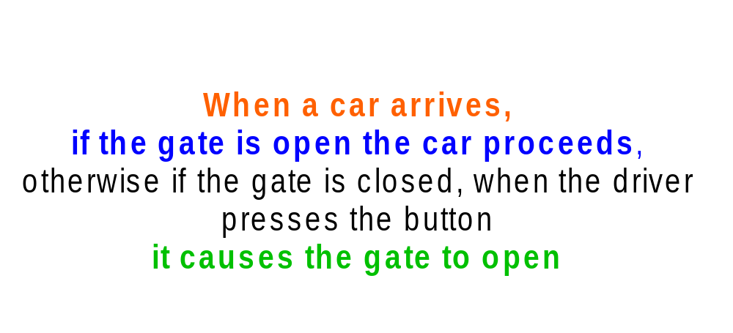
Functional Requirement
Requirements Translation Behavior Tree

Slide 18
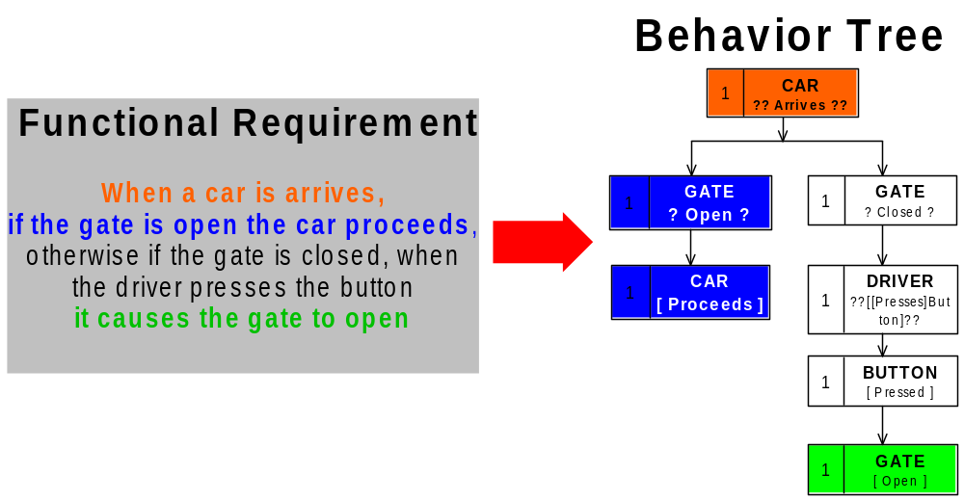
Requirements Translation
Informal => Formal

Slide 19
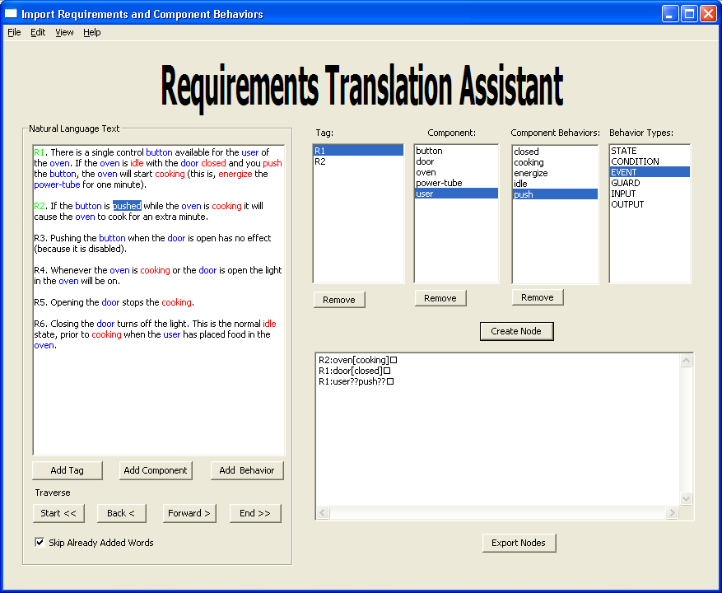

Slide 20
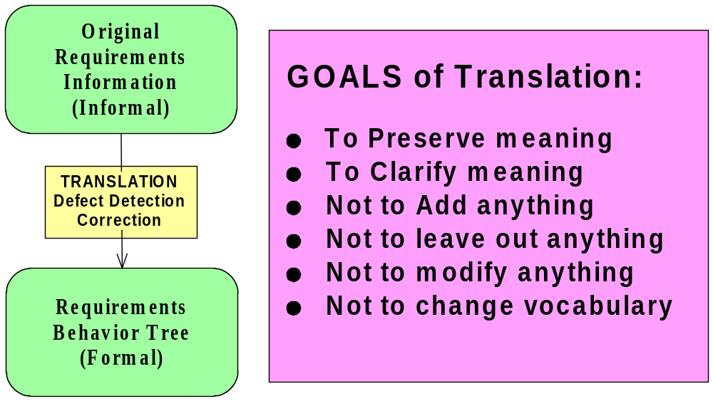
Requirements Translation

Slide 21

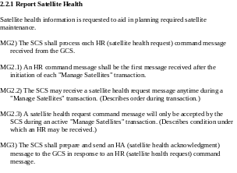


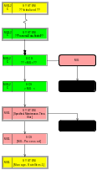
When Lots of Requirements
FR-01
Behavior Tree
Behavior Tree
FR-02
Behavior Tree
FR-M
Behavior Tree

Slide 22
Behavior Tree
Notation

Slide 23
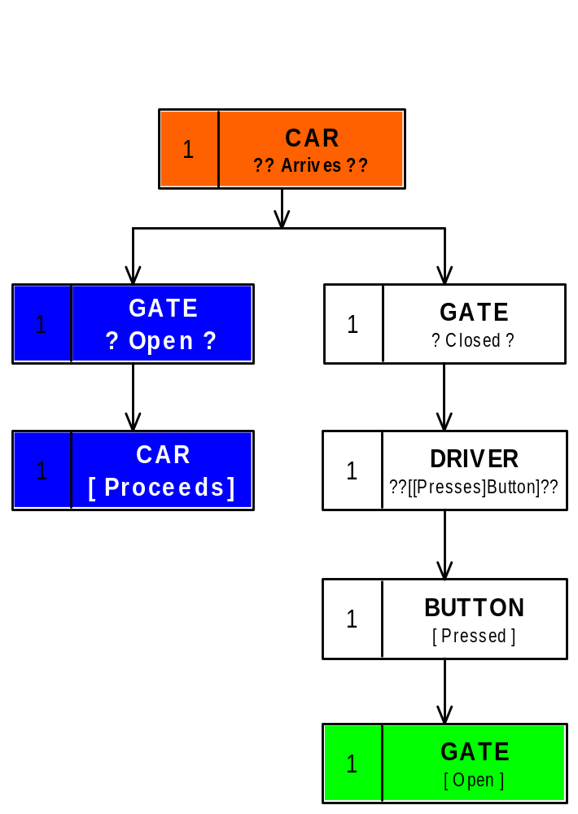
Behavior Tree Notation
Event

Slide 24
Behavior Tree Notation
Condition

Slide 25

Behavior Tree Notation
State
Realization

Slide 26
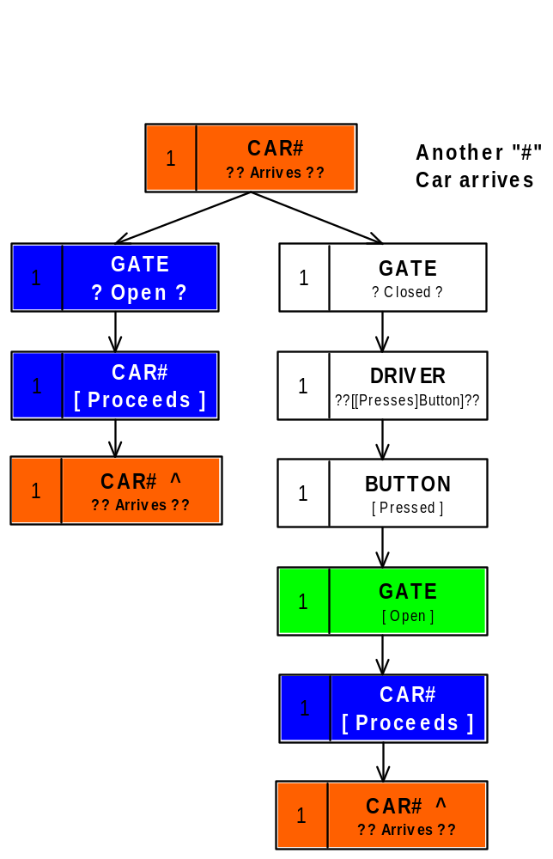
Behavior Tree Notation
Reversion = “^”
Revert back and repeat
earlier behavior
Reversion
Reversion

Slide 27
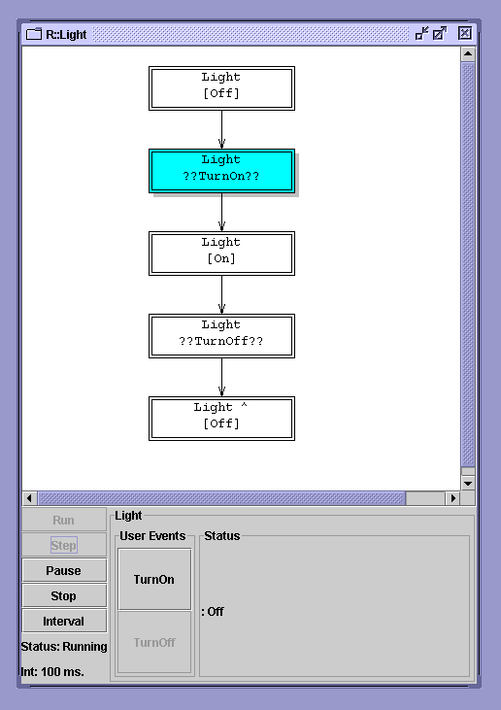
Another Example – a simple BT executed in BECIE

Slide 28
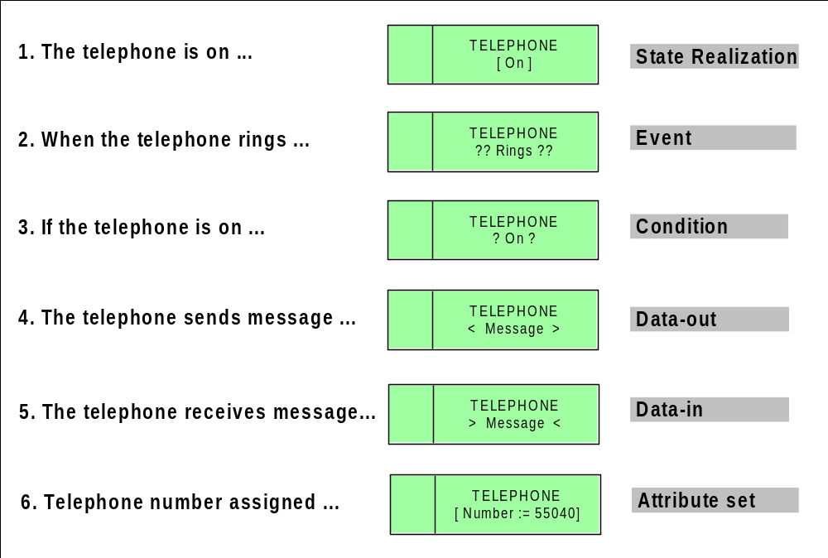
Behavior Tree Notation
Core Elements

Slide 29
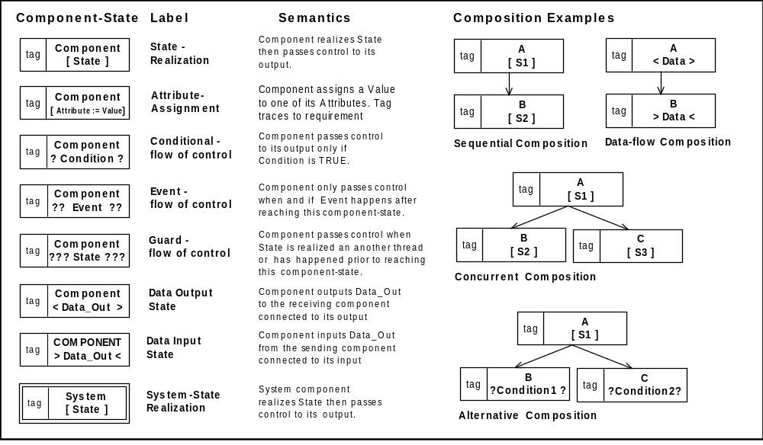
Behavior Tree Notation
Core Elements

Slide 30
Step 2.
Requirements Integration
Putting the pieces together

Slide 31

Creating an Integrated View
Order is not important BUT position where placed is
Information about “f” is spread across THREE pieces
Only see there are missing pieces when integrate pieces
Only see some pieces don’t fit when integrate pieces
Same IDEAS apply with requirements

Slide 32
Enabler - Precondition Axiom
Each and every functional requirement expressed as a behavior tree BT_{i} has
associated with it a precondition P_{i} that
needs to be satisfied in order for the
behavior encapsulated within it to be
exhibitable
P-01
P-02
P-03
P-N
BT-01
BT-02
BT-03
BT-N
•••

Slide 33
Enabler - Interaction Axiom
P-03
BT-03
Matching
Precondition
P_{x}
P_{x}
Root Node
Behavior Tree
BT-X
Behavior Tree

Slide 34
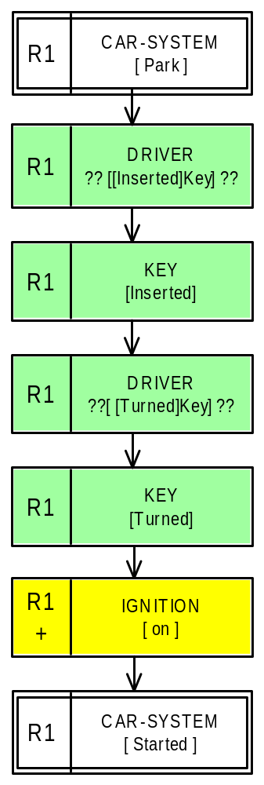
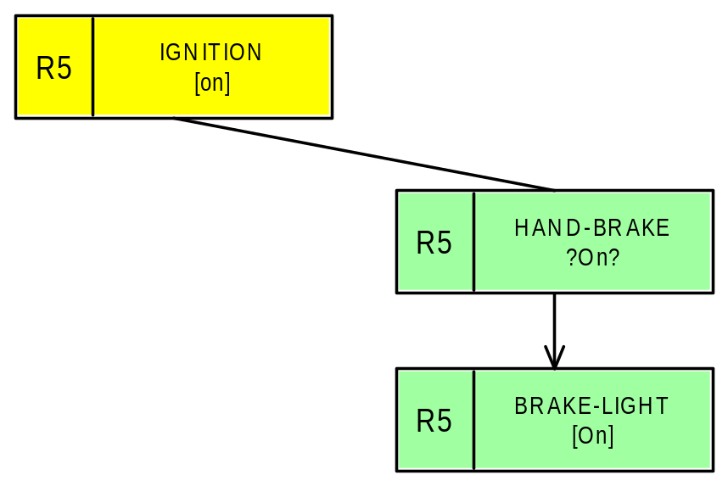
Requirements Integration
Root Node
Matching Node

Slide 35
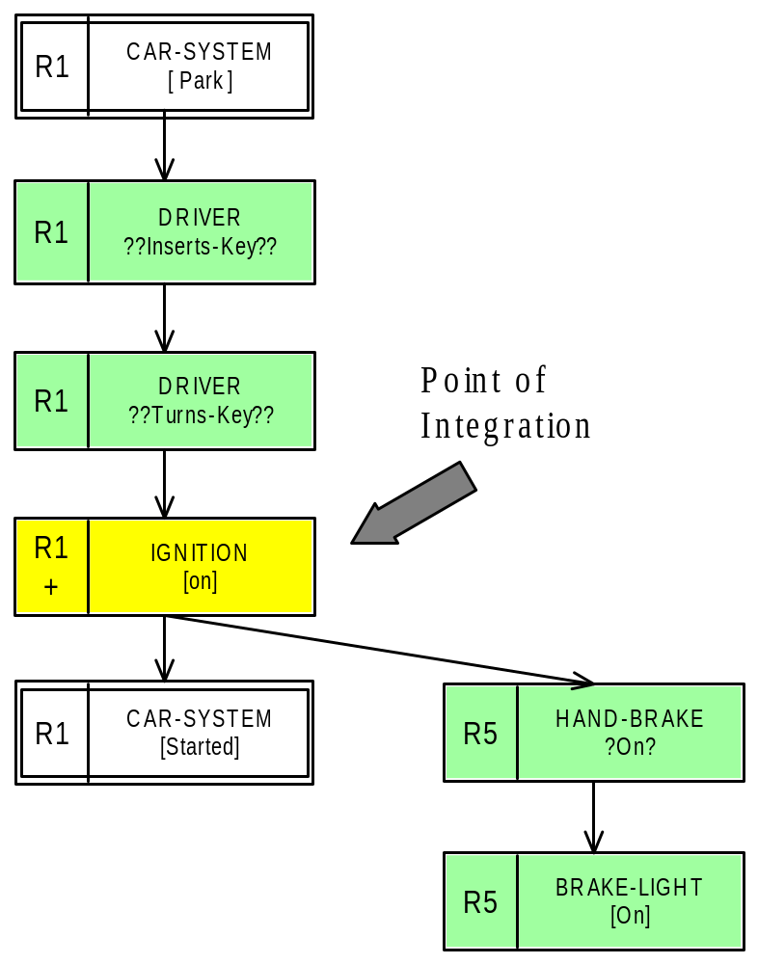
Requirements Integration

Slide 36
How Does This Help ?
If we have a large number of requirements each can be INTEGRATED into a behavior tree
ONE AT A TIME
It allows us to deal with complexity

Slide 37
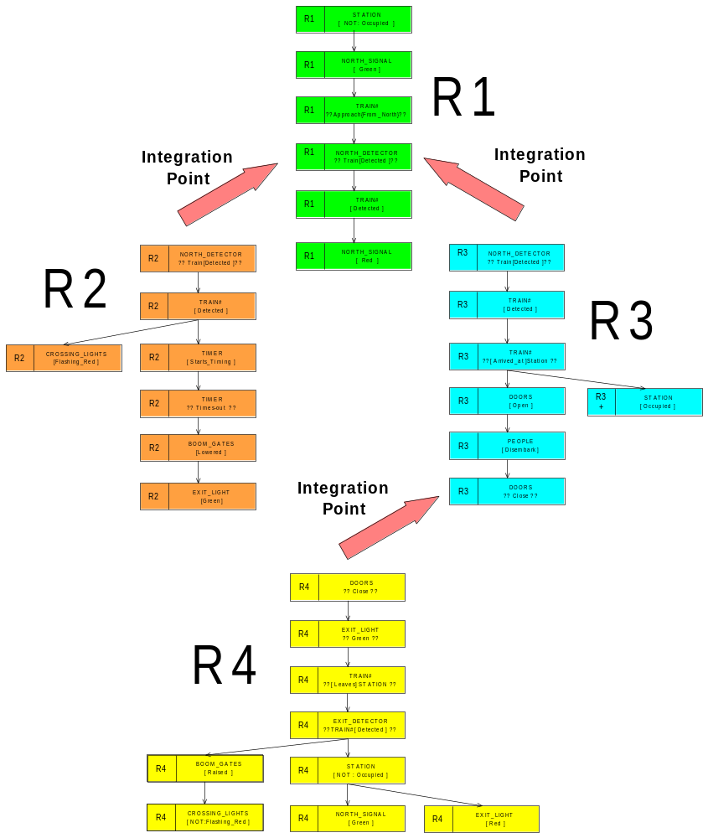
Requirements Integration

Slide 38
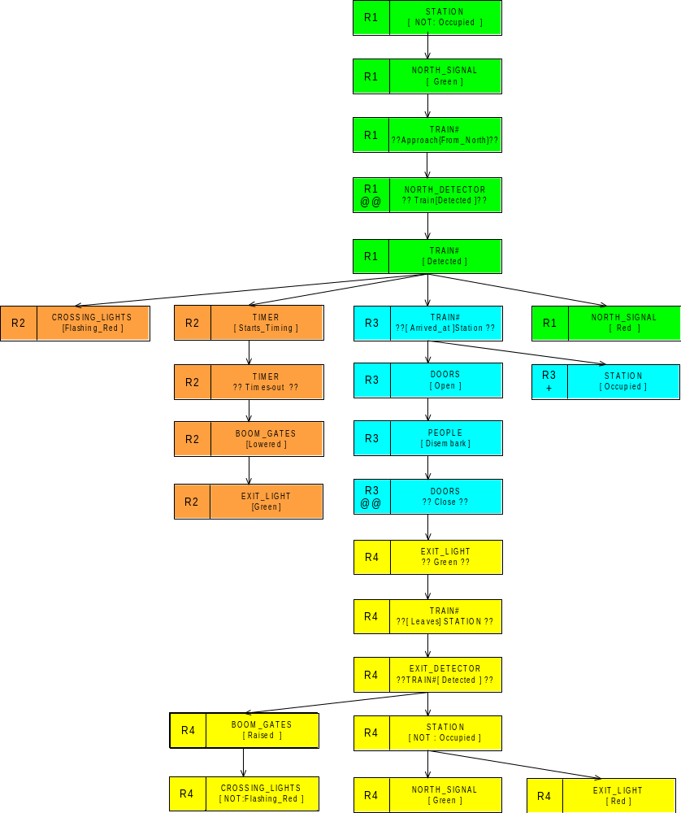
Requirements Integration
Build system out of its requirements

Slide 39
An
Example

Slide 40
Example – Car, Traffic Light System
R1: When a car approaches the light, the driver checks the light.
R2: If the light is red, the driver brakes and the car will stop.
R3: If the light is green, the driver proceeds.

Slide 41
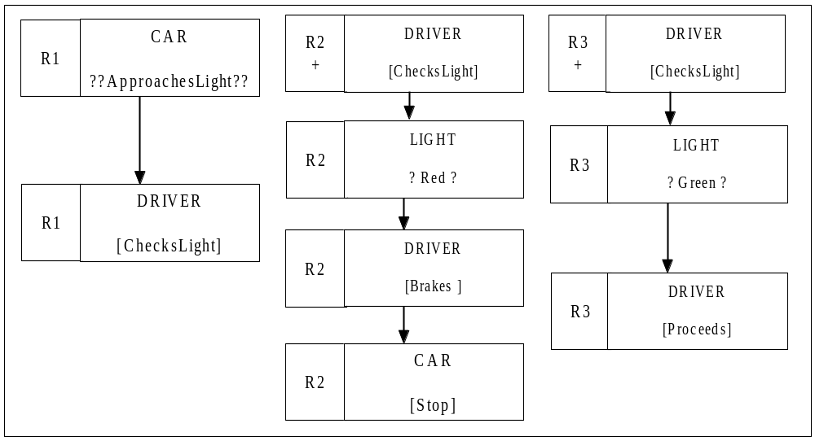
Translated Behavior Tree
The “+” sign means that piece of behavior is implied by the requirements

Slide 42
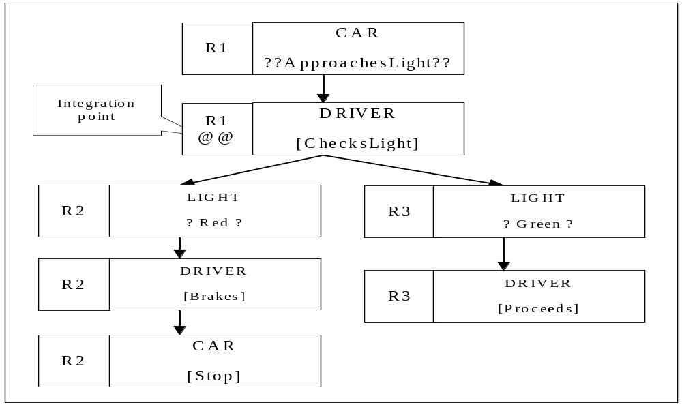
Integrated Behavior Tree

Slide 43
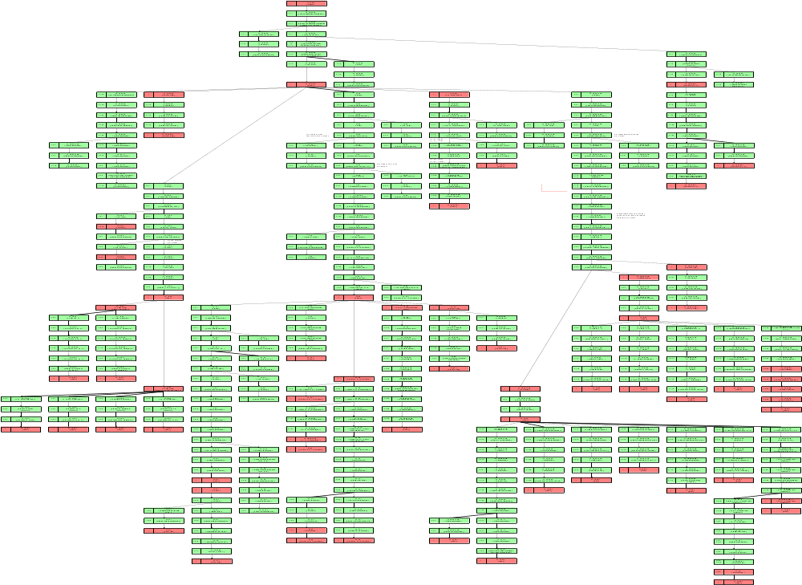
Integrated Behavior Tree – a large system
Larger system – 40 pages

Slide 44
Integrated Views
- Advantages

Slide 45
Integrated View => Understanding
The process of creating an integrated
behavior tree does a sophisticated
re-ordering of the original textual
information needed so that it can be
understood deeply, accurately and
quickly without taxing and exceeding
the limits of our short-term memory.

Slide 46
Integration => Defect Detection
A second important advantage of
the IBT representation is that
the process of translation and
integration uncovers incompleteness,
inconsistency and redundancy
defects in the original text that are
otherwise very hard to discover
because of the limitations of our
short-term memory.

Slide 47
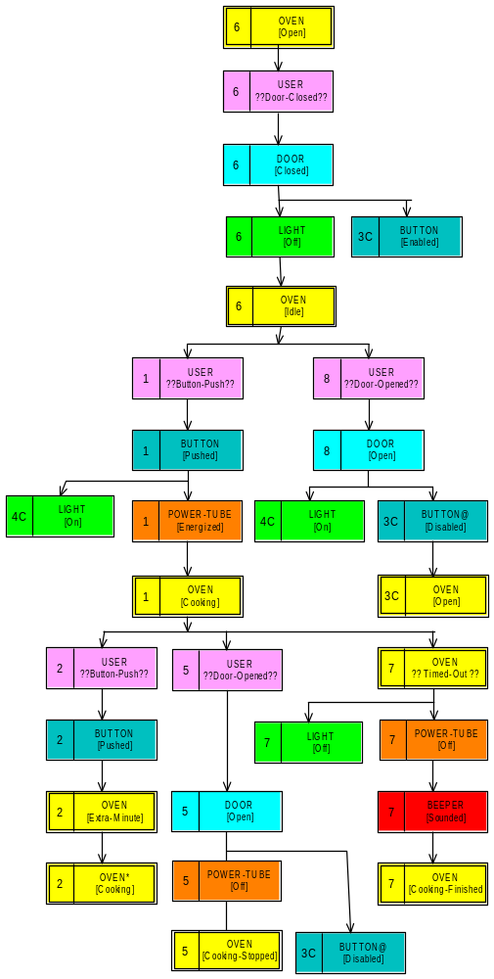
Component View
Integrated
Behavior Tree
R6
Result of integrating eight functional requirements
R8
= DOOR
R5
Components are Dispersed across requirements

Slide 48
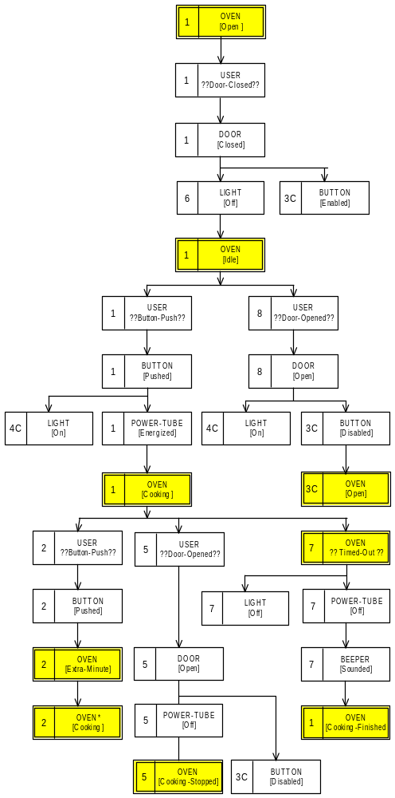
Component Behavior Tree (CBT) Projection
Component Projection
Oven Component = System Component

Slide 49
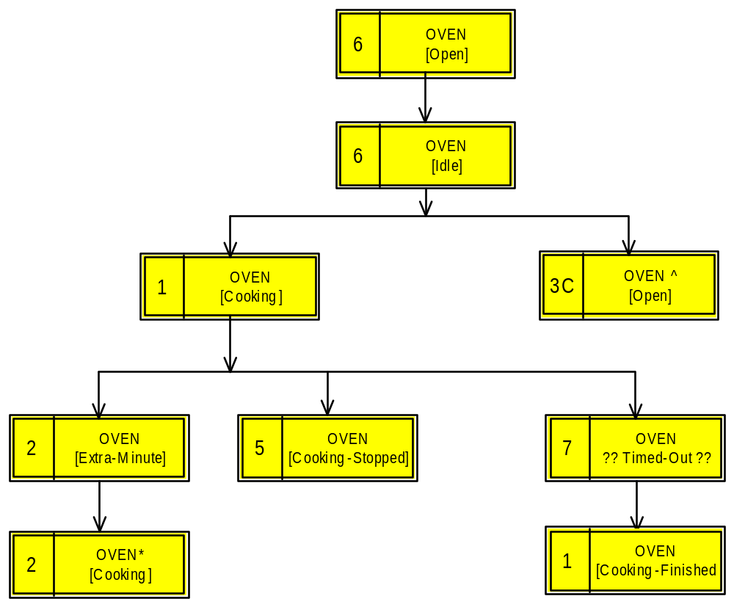
Component Behavior Tree (CBT) Projection
System
Component
Projection
Component
Projection
Oven Component = System Component

Slide 50
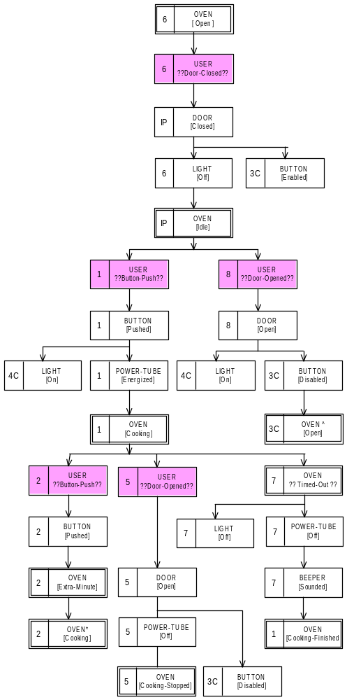
Component Behavior Tree (CBT) Projection
Component Projection
User-Interface Component

Slide 51
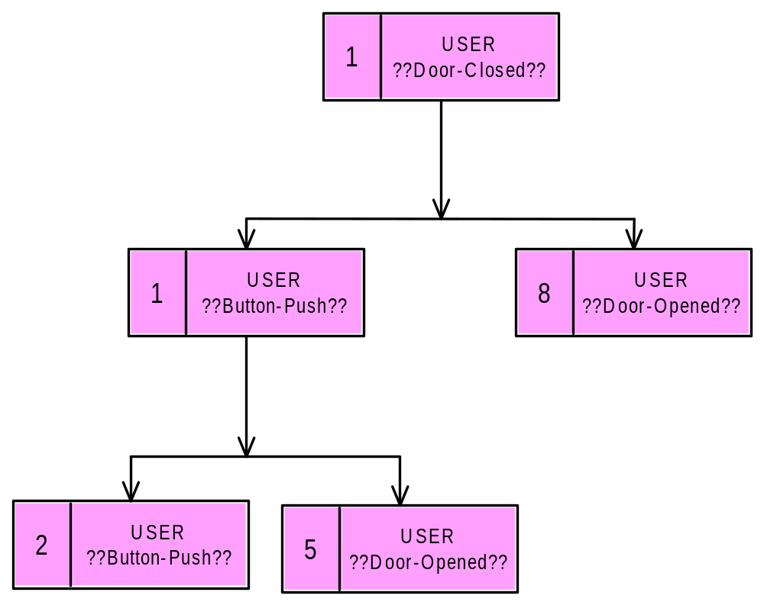
Component Behavior Tree (CBT) Projection
USER
Component
Projection
Component
Projection
User-Interface Component

Slide 52
Architecture Transformation
The Transformation Process

Slide 53
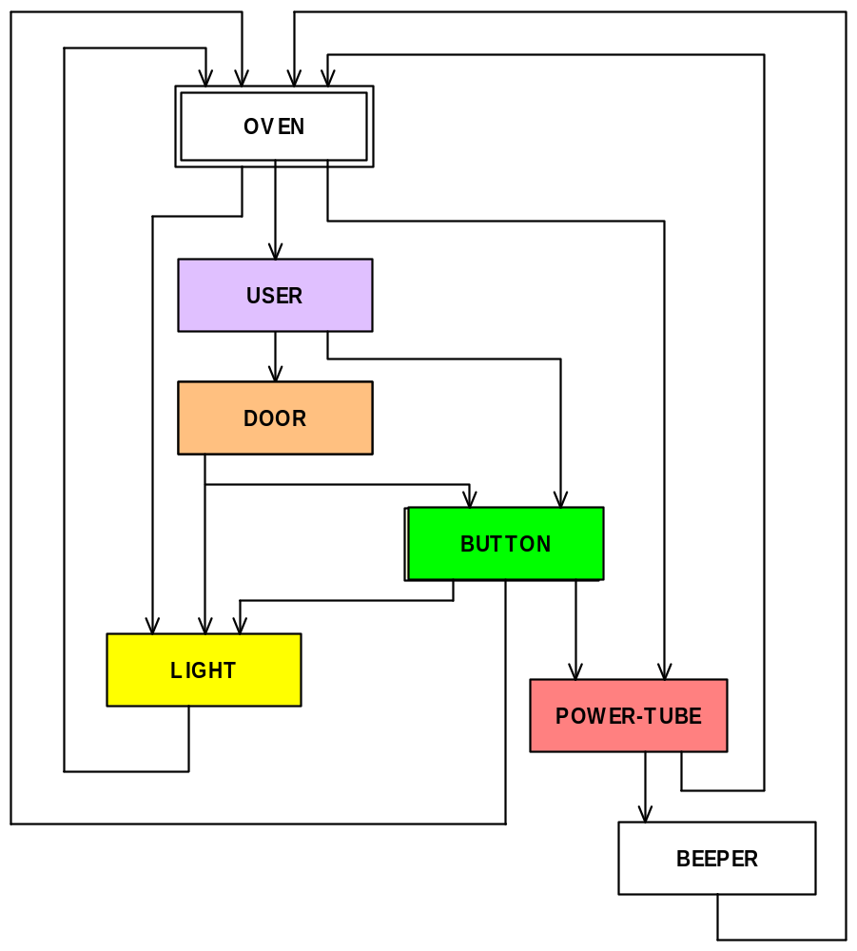
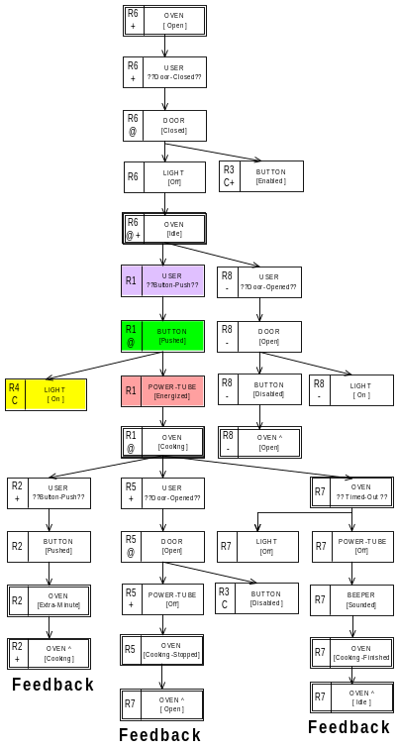
Architecture Transformation
All behaviors
merged in
together
Each Component
Occurs MANY times
Each Component
Occurs just ONCE
System – Network of Component Interactions

Slide 54
Architecture Transformation
All behaviors
merged in
together
System – Network of Component Interactions

Slide 55
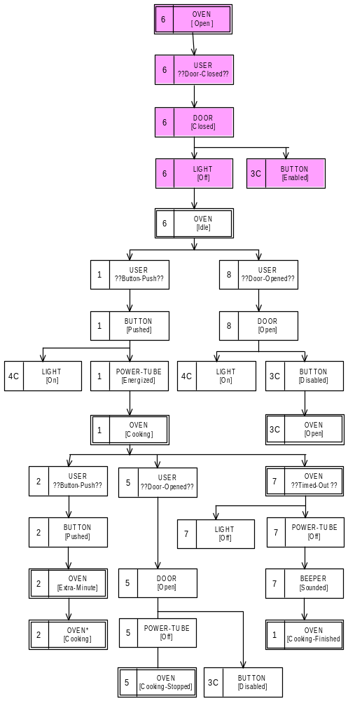
Architecture Transformation
Design
Behavior Tree

Slide 56
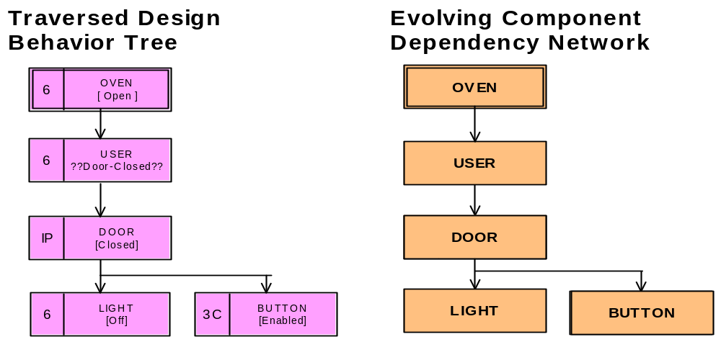
Proceed down tree while unique components
Traverse DBT from Root

Slide 57
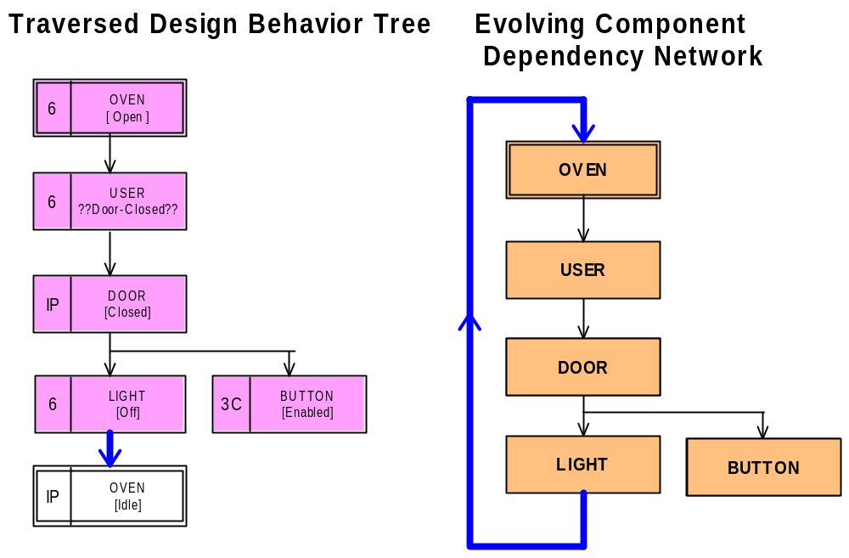
Level 5 - Transformation
Level 5 Processing

Slide 58
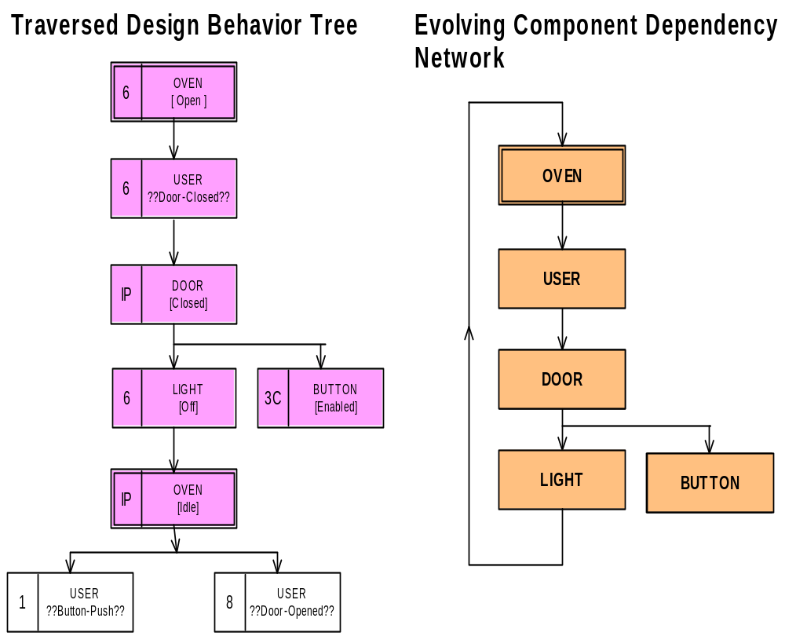
Level 6 - Transformations
Level 6 Processing

Slide 59
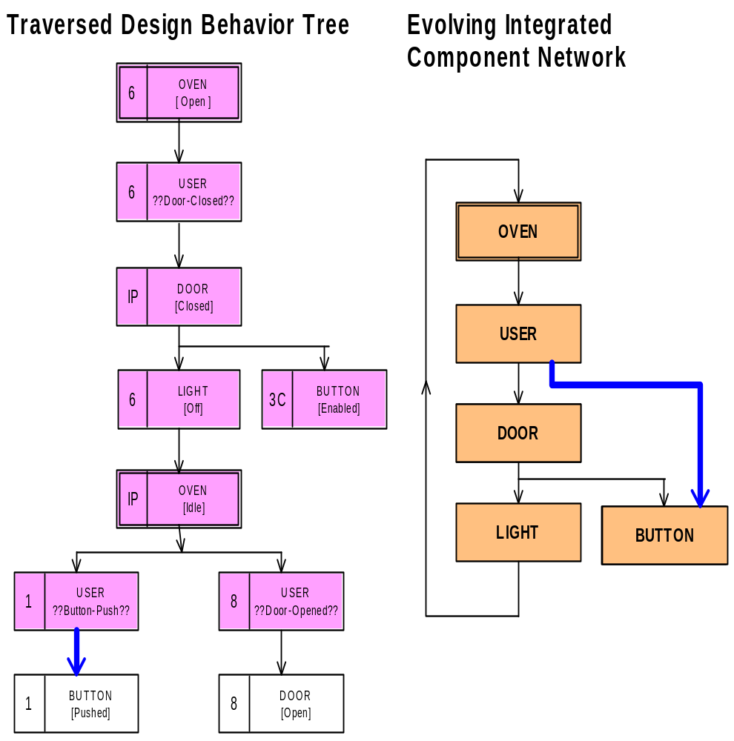
Level 7 - Transformation
Level 7 Processing

Slide 60
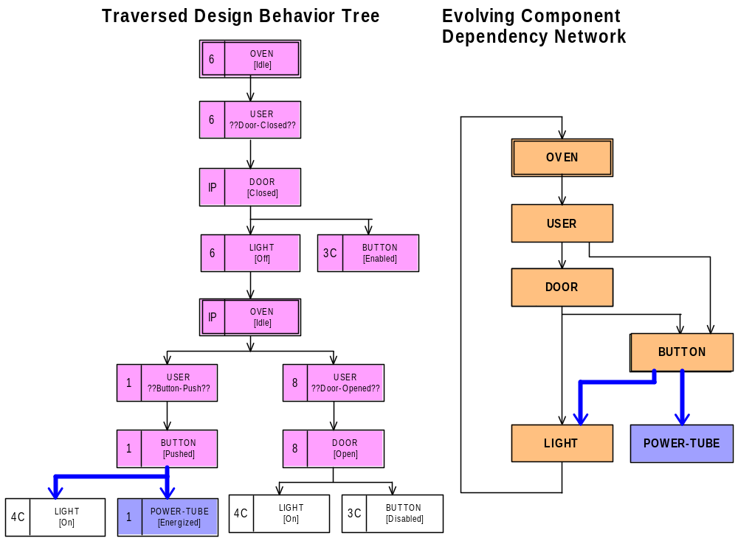
Level 8 - Transformations
And so
on …
until all
levels are
processed
Level 8 Processing

Slide 61
Component Interaction Network(CIN)
All behaviors
merged in
together
System – Network of Component Interactions

Slide 62
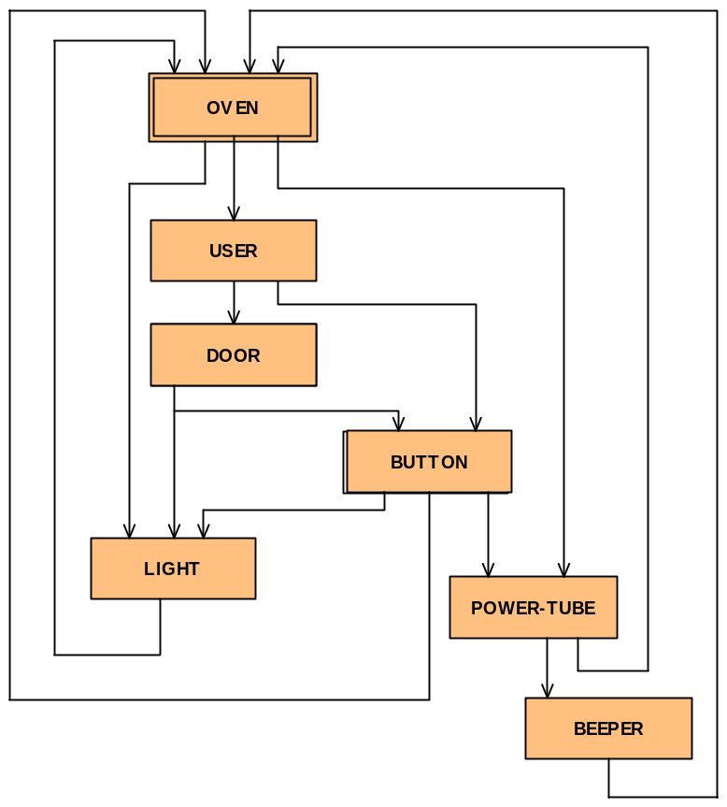
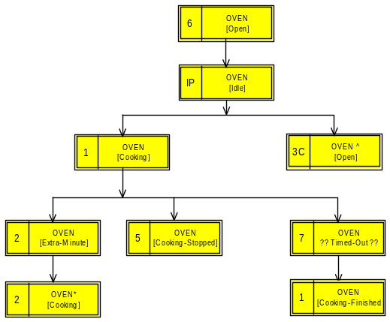
External Behavior Interface

Slide 63
Network Behavior
BEHAVIOR
User presses button
Light goes on
Power-tube energized
Oven is cooking
1
2
4
3
Behavior propagates
across network

Slide 64
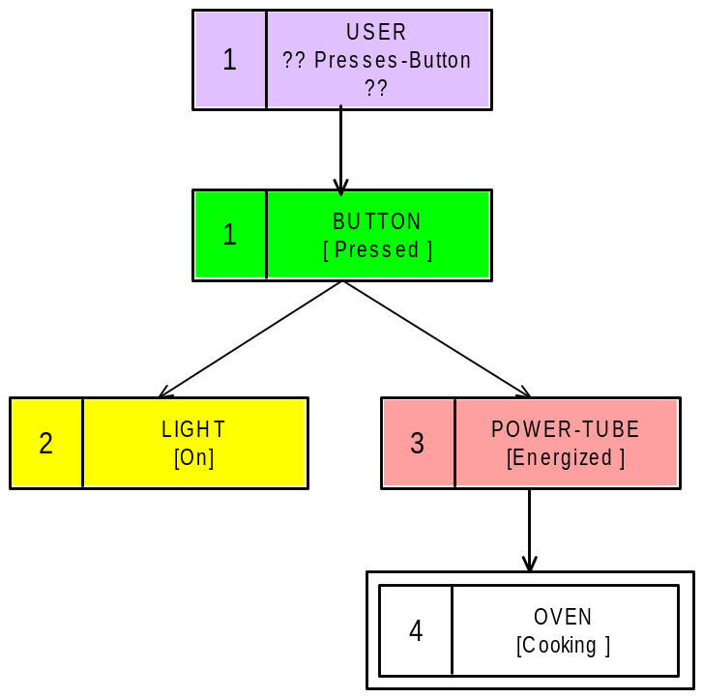
Network Behavior
BEHAVIOR
User presses button
Light goes on
Power-tube energized
Oven is cooking
1
2
3
4

Slide 65
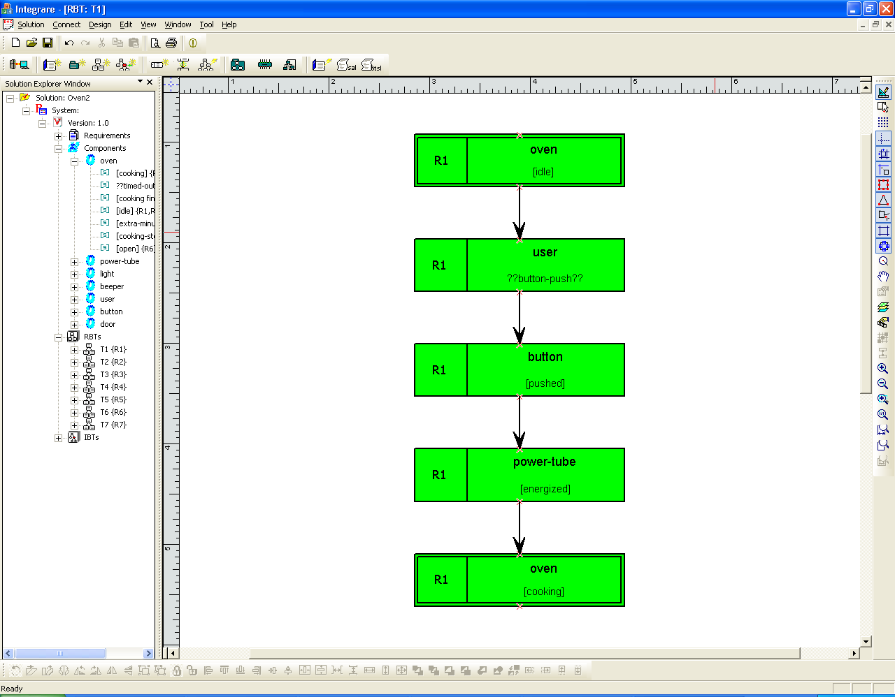
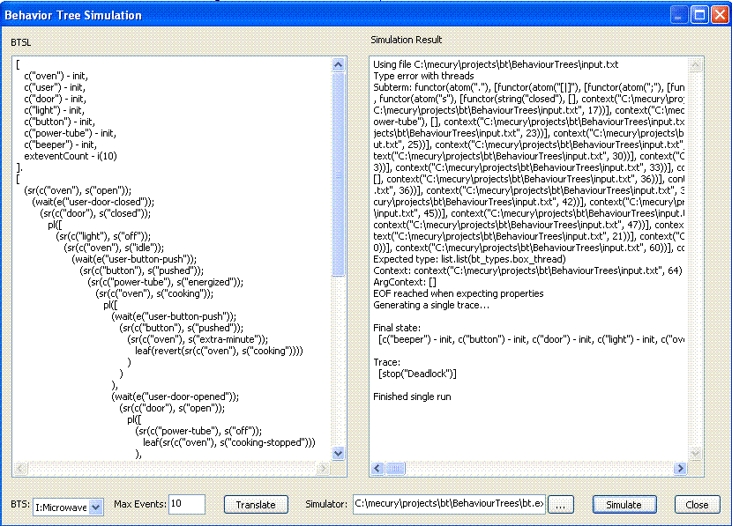
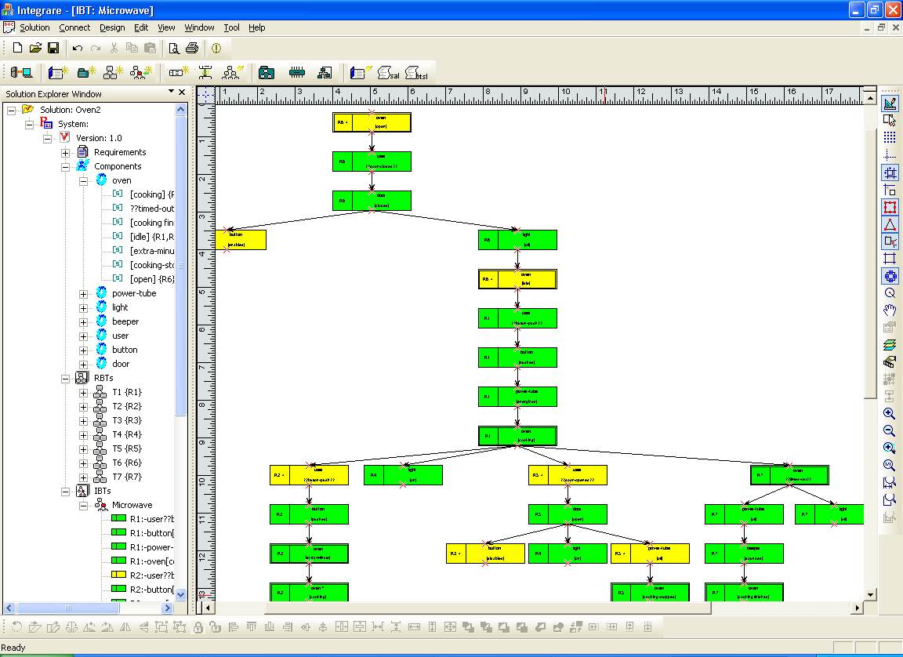
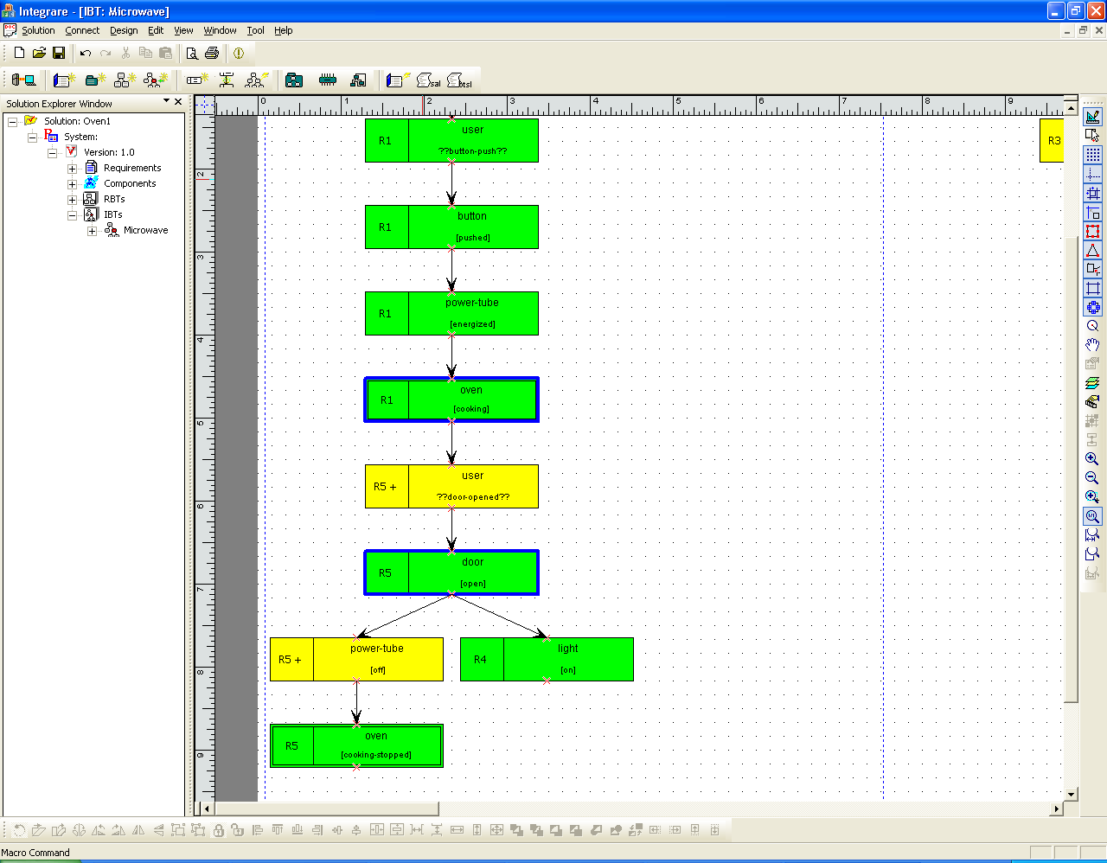
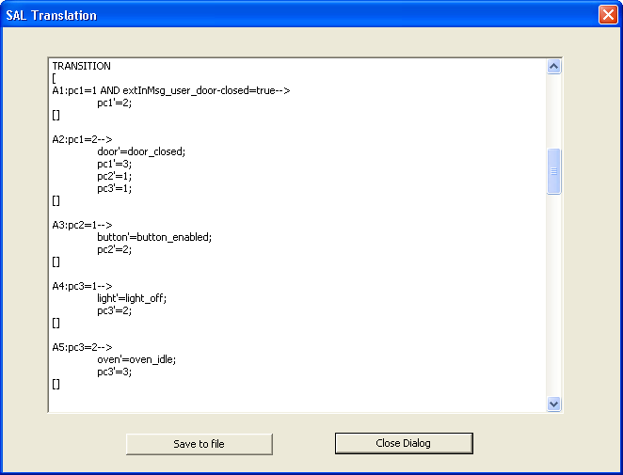
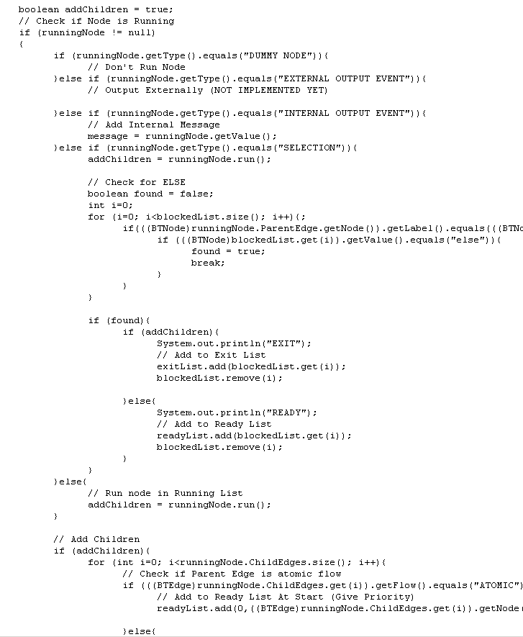
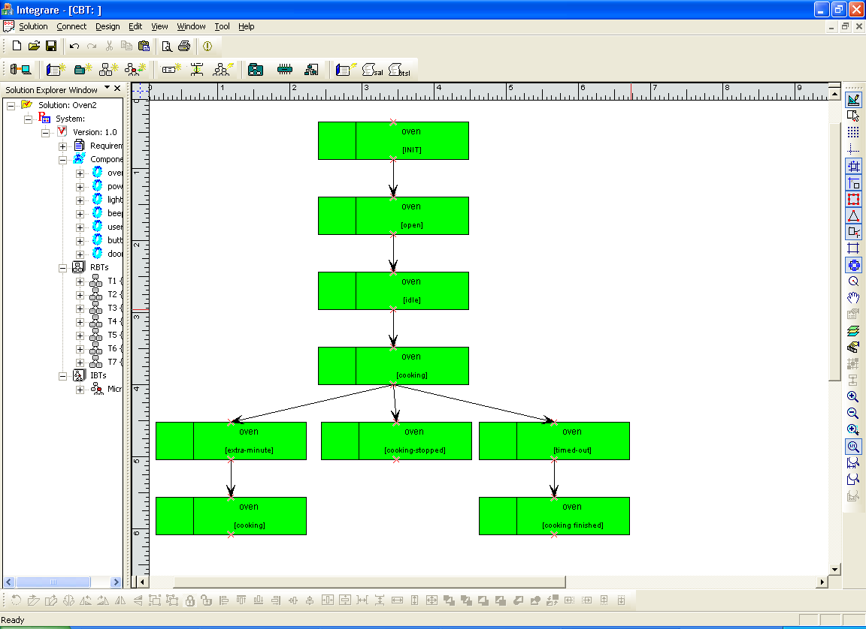
Building Dependable Systems
Informal Requirements
Requirements Translation
Requirement Behavior Trees
R1. There is a single control button available for the user of the oven. If the oven is idle with the door closed and you push the button, the oven will start cooking (this is, energize the power-tube for one minute).
R2. If the button is pushed while the oven is cooking it will cause the oven to cook for an extra minute.
R3. Pushing the button when the door is open has no effect (because it is disabled).
R4. Whenever the oven is cooking or the door is open the light in the oven will be on.
R5. Opening the door stops the cooking.
R6. Closing the door turns off the light. This is the normal idle state, prior to cooking when the user has placed food in the oven.
R7. If the oven times-out, the light and the power-tube are turned off and then a beeper emits a sound to indicate that the cooking is finished.
Simulation
Integrated Behavior Tree
Requirements Integration
Verification
Implementation
Component Behavior Tree

Slide 66
Summary
What are the three major problems for making large software systems? How BE address the solutions to those problems?
What is the fundamental difference between BE approach and traditional approach to making software design?
What are the advantages to use Behavior trees to model user requirements?
Why tree-structured graphs are usually better than general graphics for modelling?
Briefly introduce the major steps of Behavior Trees approach to making component-based software design
To be familiar with common BE notations. E.g. state-realization, condition, event, guard, reversion, implied and missing behaviours
What are they goals for requirement translations in BE approach?
What are the advantages to have an integrated behaviour tree?
How to project out CBTs and a CIN from an IBT (DBT)? What’s the usage for a CIN and CBTs?

